Slide 1
SIMATS ENGINEERING Saveetha Institute of Medical and Technical Sciences Thandalam,Chennai-602105
TITLE : Secure Cloud File Sharing System
COURSE NAME : Computer Networks
COURSE CODE : CSA0735
PRESENTED BY :
S.Lekha (192511104)
Thanushree (192524236)
Mohammed Ubed (192525115)

Slide 2
LIST OF CONTENT
ABSTRACT
USER AUTHENTICATION & ACCESS CONTROL
FILE ENCRYPTION AND SECURE UPLOAD
SECURE FILE SHARING SYSTEM
ACCESSS CONTROL MODULE
ADMIN PANEL
TECHNIQUES USED
CONCLUSION
1.ABSTRACT
2.INTRODUCTION TO CLOUD FILE SHARING
MODULE 1: USER AUTHENTICATION & ACCESS CONTROL
MODULE 2: FILE ENCRYPYION & UPLOAD
MODULE 3: SECURE FILE SHARING
TECHNIQUES
CONCLUSION

Slide 3
ABSTRACT
secure cloud file sharing system allows users to store, access, and share files via the cloud while ensuring data confidentiality, integrity, and access control. It integrates encryption, multi-factor authentication, and role-based permissions to prevent unauthorized access, making file sharing both efficient and secure

Slide 4
USER AUTHENTICATION & ACCESS CONTROL
User Authentication: Only authorized users can access the system (passwords, OTPs, biometric logins)
Multi-Factor Authentication (MFA): Adds an extra layer of security for user accounts.by verifying their identity using two or more factor
Role based or file level permission (read,write,share)
read: view file only
write: edit or upload new version
share: give access to others
Auto logout after inactivity . this prevents session hijacking and protects data if a user forgets to logout.

Slide 5
Audit Logs: Track all file activity, including uploads, downloads, and modifications.
Access Control: Granular permission settings allow file owners to control who can view, edit, or download files.
Data Integrity: Ensures files are not altered during transfer or storage using hashing or digital signatures.
Backup & Recovery: Regular backups and disaster recovery plans ensure file availability during system failures.

Slide 6
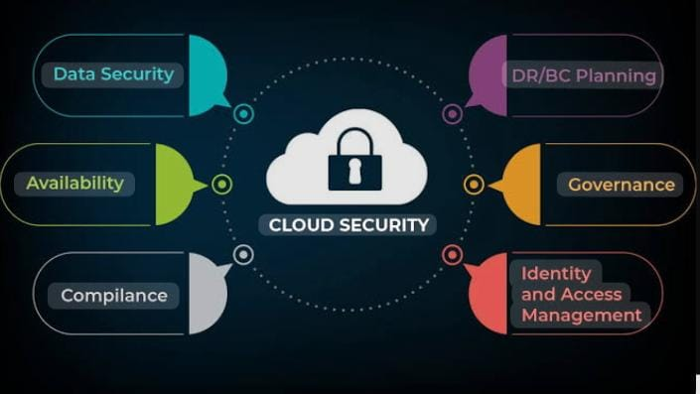

Slide 7
FILE ENCRYPTION AND SECURE UPLOAD
This module ensures that all files are protected during both storage and transmission. The goal is to prevent unauthorized access and data links
🔹 Responsibilities :Encrypt files before storing (at rest)Decrypt only for authorized users (zero-knowledge encryption optional)Store metadata (owner, timestamps)
Secure transmission: when the files are transferred between users and cloud ,TLS(transport layer security) or SSL is used . this protects the data from being intercepted during upload or download.
Once uploaded, file remains encrypted in the cloud storage . even the cloud provider cannot read the fie contents unless they have the key
This maintains data confidentiality at rest and safeguards against internal or external threat

Slide 8
🔹 Key Features:AES-256 encryption (symmetric)RSA or ECDH key exchange (asymmetric)Storage on AWS S3 / GCS / Azure BlobEncrypted metadata for privacy
🔹 Tech Stack:Crypto: Crypto module in Node.js or cryptography in PythonStorage: AWS S3 with encryption-at-rest (SSE-C, SSE-KMS)Metadata DB: MongoDB / PostgreSQL
🔹 Sample Flow:cssCopyEdit[File Upload] → [Encrypt file locally or server-side] → [Store in Cloud Storage] + [Store metadata in DB]

Slide 9
Secure File Sharing
Secure file sharing is the process of transferring digital files saftly over a network. Usually the internet while protecting the datafrom un authorized access, tempering or theft
🔹 Responsibilities:Generate secure shareable linksSet permissions (read-only, edit, delete)Add expiration, password-protection Notify recipient (email, SMS)
🔹 Key Features:One-time or expiring linksPassword-protected accessAudit trail: who accessed and whenEmail/SMS verification for external sharing
🔹 Tech Stack: Backend: REST API or Graph QLDB: Store share token, permissions, expiry Crypto: Token hashing (HMAC)

Slide 10
Used in:
Cloud storage ( Google drive , Dropbox ,OneDrive)
Business collaboration tools
Healthcare , finance, and legal sectors where data privacy is criyical

Slide 11
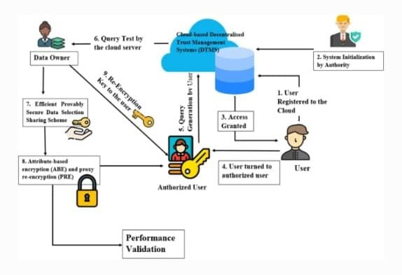

Slide 12
ACCESS CONTROL MODULE
PURPOSE:
To prevent unauthorized users from accessing or downloading sensitive files stored in the cloud system.
Features:
Role-based access control
Supports different user roles: Admin, User
File-level permissions
Define specific permissions such as:
View
Download
No Access
Controlled access
Only the file owner and users with whom the file is shared can access it.
Flow:
When a user sends a request to access or download a file:
The backend system checks the user's role and file permissions.
If the user has the correct access rights, the file is provided.
Otherwise, access is denied.

Slide 13
Audit and Activity Logs
Purpose:
Keep track of all actions for security and monitoring.
Features:
Log user logins, uploads, downloads, and shares.
View logs in admin dashboard.
Detect unauthorized or suspicious behavior.
Example:
“User A downloaded file X at 2:13 PM”
“User B failed login attempt – IP logged”

Slide 14
Admin Panel
Purpose:
Provide administrative control and system overview.
Features:
View user list, block/unblock users
Access system activity logs
Monitor file sharing patterns

Slide 15
TECHNIQUES USED
AES/RSA Encryption : for secure file protection
TLS Protocol: for secure data transfer
MFA (OTP , Authenticator app ):for login security
Role Based access control : ensures only authorized users can perform actions.
Logging Frameworks: for audit trails.

Slide 16
CONCLUSION
A secure cloud file sharing system protects sensitive data from unauthorized access while enabling safe and controlled file exchange.
Strong authentication , encryption and secure file sharing yhe system ensures confidentiality , integrity and accountability in the cloud.

